Slide 1
Housing Market
Tamara Hundich

Slide 2
Original Plan: Create a model that would predict the home value price
Issue: Median sales price was not constant, therefore skewed results. Changed to categorical value.
New Plan: Can a model be created to predict the correct property type?

Slide 3
Configuration
Pulled data from Redfin
Placed data into Postgres SQL
Cleaned data and placed into Dataframes by using combination of Python and Postgres
There were total of 35,424 records in this dataset.
1,417 of these records were dropped due to Null values. (4.8% of the data had to have been dropped due to null values)

Slide 4
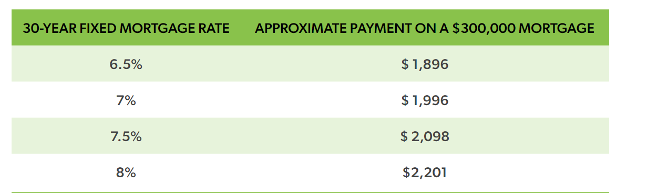
Why?
Per Freddie Mac, the current interest rate for a 30-year FRM mortgage is 6.88% and a 15 yr FRM is 6.22%. Is now the right time to purchase?

Slide 5





PROPERTY TYPES
MULTIFAMILY (2-4 UNITS)
CONDO
TOWNHOUSE
ALL RESIDENTIAL
SINGLE FAMILY RESIDENT

Slide 6
What was included in the Data?
Some examples include:
Month & Year for sale of property
Median Sales Price
&
Median List Price
Number of inventory
All 50 states and Washington D.C.

Slide 7
Data Models

Slide 8
Models Created
Linear Regression
Neural Network
Kmeans Clustering

Slide 9
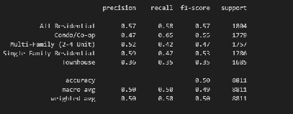
LINEAR REGRESSION
Even though the desired accuracy was 75%, this was the best fit model for this dataset.
50% Accuracy Rating

Slide 10
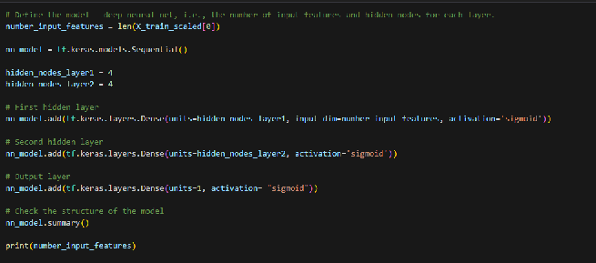

NEURAL NETWORK

Slide 11

NEURAL NETWORK ORIGINAL CODE
50 Epochs
2 Hidden Nodes Layers
Activation: Sigmoid
Loss: Binary Crossentropy
20% Accuracy Rating

Slide 12


STRATEGY
1
2
3
4
5
CHANGING LOSS
Reasearched online instead of binary: categorical
ADDED ADDITIONAL NODE LAYER
CHANGED ACTIVATION
ADDED COLUMNS
CHANGED EPOCHS
Even with all these changed, the accuracy rating either decreased or remained at 20%.

Slide 13
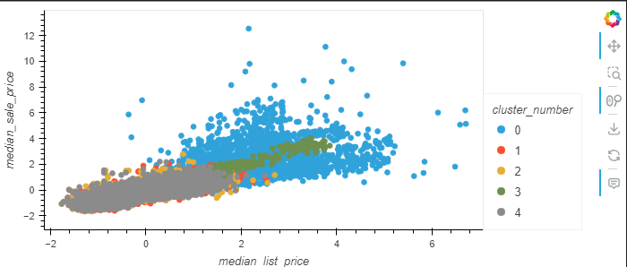
KMEANS CLUSTERING
Clustered by property type
0 = Multi-family 3= All Residential
1= Condo 4= Single Family Resident
2 = Townhouse
Multi-family homes had a higher median sale price
and higher median list price compared to the other
property types.

Slide 14
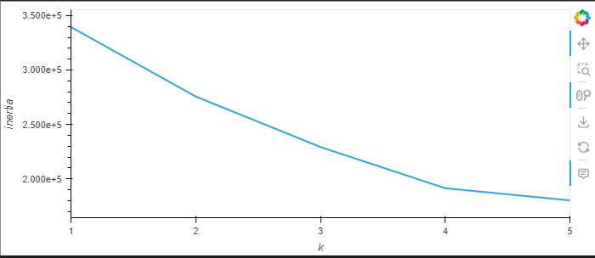
KMEANS
K = 5, since the 0 is missing off graph

Slide 15
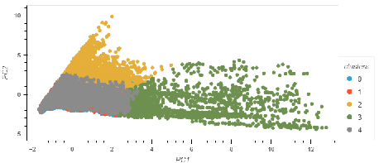
KMEANS

Slide 16
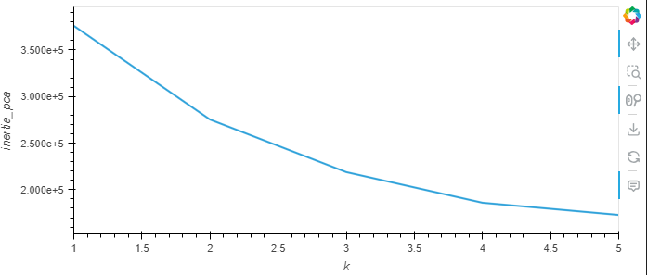
KMEANS

Slide 17
CONCLUSION
LINEAR REGRESSION
NEURAL NETWORK
Despite only have a 50% accuracy rating, the linear regression model was the best fit model.
With the neural network model, even with all changes, the accuracy score still remained at 20%.
OPPORTUNITIES
KMEANS
Looking for a new dataset that may contribute to a higher accuracy rating.
Other opportunity would be to explore a new machine learning model.
Those that were in the cluster 2 had the highest median sale price.
Even with multiple models created, the desired results were not obtained.

Slide 18


RESOURCES
Downloadable Housing Market Data - Redfin
Mortgage rates and affordability - My Home by Freddie Mac

Slide 19
QUESTIONS?

